Slide 1
Professional Practices
Ethics
It is not enough that you should understand about applied science in order that your work may increase man’s blessings. Concern for man himself & his fate must always form the chief interest of all technical endeavors.
(Albert Einstein)

Slide 2
Week 3 Lec 5
Introduction and History of Ethics
Types of Ethics
Relationship between Law and Ethics
Computer Ethics

Slide 3
What is Ethics?
Derived from a Greek word eché, which means character
It may be defined as the set of moral principles that distinguishes Between right and wrong.
It has a twofold objectives:
it evaluates human practices by calling upon moral standards; also
it may give prescriptive advice on how to act morally in a given situation.
Ethics, therefore, aims to study;
both moral & immoral behavior
in order to make well-founded judgments and to arrive at adequate recommendations

Slide 4
Importance of Ethics
Goodness without knowledge is weak.
Knowledge without goodness is dangerous.
Person A finds a briefcase full of important documents and money, he throws the paper and keeps the money.
The action differs from society to society
Most people feel no regret when they are apprehended because their ethical standards differ from those of society as whole
If a criminal were truly aware of the mental and spiritual consequences of his actions, he would neither commit nor even consider committing them.

Slide 5
Types of Ethics
Personal Ethics
Social Ethics
Business Ethics
Religious Ethics
Professional Ethics
Computing Ethics

Slide 6
Personal Ethics
Standards that has been chosen in some way as a moral guide in the particular life style.

Slide 7
Social Ethics
Standards that govern how members of a society are to deal with each other on issues such as fairness, justice, poverty and the rights of the individual.
OR
The rightness of an action is based on the customs and norms of a particular society or community (e.g., the usual way things are done around here)

Slide 8
Business Ethics
Business ethics is the study of good and evil, right and wrong, and just and unjust actions in business.
Although all managers face difficult ethical conflicts, applying clear guidelines resolves the vast majority of them.
Ethical traditions that apply to business support truth telling, honesty, protection of life, respect for rights, fairness, and obedience to law.
Eliminating unethical behavior may be difficult; but knowing the rightness or wrongness of actions is usually easy.

Slide 9
Religious Ethics
Ethics, which is a major branch of philosophy, includes right conduct and good life. It is significantly broader than the common conception of analyzing right and wrong. A central aspect of ethics is "the good life", the life worth living or life that is simply satisfying, which is held by many philosophers to be more important than traditional moral conduct.
Some assert that religion is necessary to live ethically. Blackburn states that, there are those who "would say that we can only flourish under the umbrella of a strong social order, covered by common devotion to a particular religious tradition”.

Slide 10
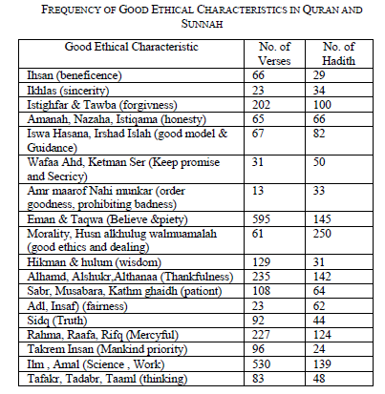
Ethics in Islam
Islam emphasizes on all aspects of ethics e.g. ethics in society, ethics in trading, banking
The ethical standards published for computing field also corresponds with Islamic ethics
[Hameed, 2009]

Slide 11
Professional Ethics
Professional Ethics: concerns one's conduct of behavior and practice when carrying out professional work, e.g., consulting, researching, teaching.
Publicly displayed ethical conduct of a profession, embedded in code of ethics.
The principles and standards that guide members of the profession in their interactions with internal & external stakeholders.

Slide 12
Why professional ethics?
Awareness of professional ethics is gaining importance with time
decision making process in the workplace is a complex phenomena
the professional ethics provide a way of simplifying that decision-making process

Slide 13
Professional Ethics Scope
Professional Ethics must take into accounts:
Relations between professionals and clients
Relation between profession and society
Relations among professionals
Relations between employee and employer
Specialized technical details of the profession
A computing professional must understand;
Cultural, social, legal, and ethical issues in computing
Responsibility and possible consequences of failure

Slide 14
Professional Ethics Benefits
Symbolize professionalism
Protect group interests
Specify membership protocol
Inspire good conduct
Educate and discipline members
Enumerate principles, express ideals
Put forth rules, offer guidelines

Slide 15
Problems with Professional Ethics
Can not cover all aspects
Who determine violations?
How are the rules interpreted?
What penalties exist for violations?

Slide 16
Computer Ethics
Computer ethics defined as the application of classical ethical principles to the use of computer technology
Ethical problems related to computers are not unique but they tend to occur on a much larger scale and scope
Fall of cyber destruction
Aspects of computer ethics:
Analysis of the nature of problems related to the social impact of computers
Formulation and justification of policies needed to manage computer technology
Details will be discussed in next lecture

Slide 17
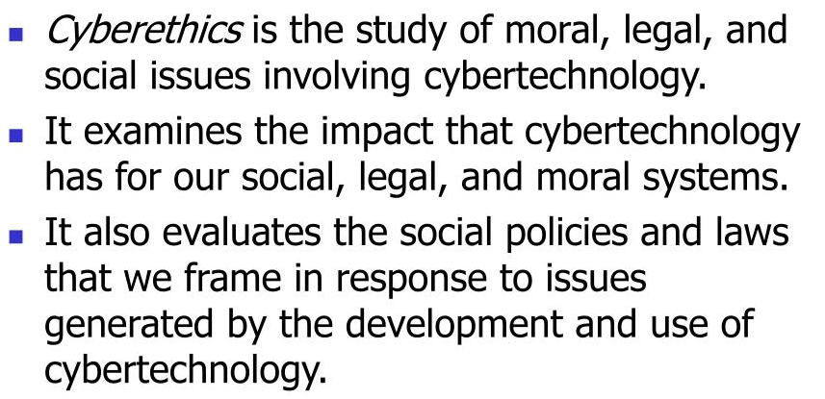
Cyberethics
Notes:
It is the philosophic study of ethics pertaining to computers, encompassing user behavior and what computers are programmed to do, and how this affects individuals and society.
For years, various governments have enacted regulations while organizations have defined policies about cyberethics.
What Is Cyberethics? • Cyberethics is the study of moral, legal, and social issues involving cybertechnology. • It examines the impact that cybertechnology has for our social, legal, and moral systems. • It also evaluates the social policies and laws that we frame in response to issues generated by the development and use of cybertechnology.
What Is Cybertechnology? • Cybertechnology refers to a wide range of computing and communications devices – from standalone computers, to "connected" or networked computing and communications technologies, to the Internet itself. • Cybertechnologies include: • hand-held devices (such as personal digital assistants); • personal computers (desktops and laptops); • large mainframe computers.
Cybertechnology (Continued) • Networked devices can be connected directly to the Internet. • They also can be connected to other devices through one or more privately owned computer networks. • Privately owned networks include both: • Local Area Networks(LANs), • Wide Area Networks(WANs).
Why the term cyberethics? • Cyberethics is a more accurate label than computer ethics, which can suggest the study of ethical issues limited either to: • computing machines, • computing professionals. • Cyberethics is also more accurate than Internet ethics, which is limited only to ethical issues affecting computer networks.
The Evolution of Cybertechnology and Cyberethics: Four Phases • Computer technology emerged in the late 1940s, when some analysts confidently predicted that no more than six computers would ever need to be built. • The first phase of computing technology (1950s and 1960s) consisted mainly of huge mainframe computers that were unconnected (i.e., stand-alone machines). • One ethical/social question that arose during Phase 1 dealt with the impact of computing machines as “giant brains” and what that meant for being human. • Another question raised during this phase concerned privacy threats and the fear of Big Brother.

Slide 18
Questions
What information about individual can be revealed to others?
What information about individuals should be kept in databases, and how secure is the information in the computer systems?
How should one handle data piracy on the computer networks?
Who is allowed to access the data and information?
How can safeguards be introduced to ensure that the information can be accessed only by the right person or organizations?

Slide 19
Considerations
Do not use rude or offensive language.
Do not cyberbully.
Do not plagiarize.
Do not break into someone else's computer.
Do not use someone else's password.
Do not attempt to infect or in any way try to make someone else's computer unusable.
Adhere to copyright restrictions when downloading material from the Internet, including software, games, movies, or music.

Slide 20
Relationship between Law and Ethics
Legal work and ethical behaviours are often entangled in a way that can be difficult to decipher.
However, it’s important to understand the difference between a legal judgment and an ethical decision, as the two may seem at odds with one another.

Slide 21
Relationship between Law and Ethics
what is ethics?
In general understanding, ethical behaviour falls under a system of morality concerned with what’s good for both individuals and society. It concerns how people should and shouldn’t behave, and different societies and cultures have different ideas of ethical behaviour.
The law (in contrast) is:
A set of rules and guidelines that are meant to be separated from ethics and morality and are enforced through social institutions like courts and law enforcement.
In general terms, the law affords punishment through fines, community service, jail time, etc. when one breaks the rules.
However, when one breaks an ethical rule, enforcement is more often public shame or the loss of personal relationships rather than money or time.

Slide 22
Relationship between Law and Ethics…
Perpetually, legal judgment and ethical judgment would be seen as wholly separate, with individuals keeping their moral bias out of the legal system.
In our current world, however, we see a mixture of law and ethics;
Laws are made based on religious ethics, for example, or judges hand down lenient sentences based on their personal view of morality. This can pose issues when a situation is clearly harmful and illegal, despite the personal feelings and opinions of the judge.
However, having a society that attempts to live ethically can also have positive results on legal judgments, as a society that is aligned in their belief of what is ethically and morally right will tend to agree on what is legally right. This means that most citizens will be “law-abiding,” obeying both the legal system and the ethical — or moral — one.

Slide 23
Relationship between Law and Ethics
How do we distinguish between what is ethical and what is legal?
Do they always align, or are there differences that we have to be aware of to protect ourselves and our clients from harm?
Every day, you make countless ethical decisions. But what do you do when faced with an ethical dilemma?
In business, ethics and legality are often even more intertwined than they are for the average person.
An ethical dilemma could lead to legal repercussions for yourself, your business, the employee who caused the issue, and even potentially your client.
It’s your job to understand where ethics and laws meet in your line of work, so you know how to handle a situation as it arises. Being prepared is the best way to prevent ethical issues from arising at all.

Slide 24
References
[Hameed, 2009] Software Engineering Ethical Principles Based on Islamic Values by Shihab A. Hameed JOURNAL OF SOFTWARE, VOL. 4, NO. 6, AUGUST 2009
[standford, 2001] Computer Ethics: Basic Concepts and Historical Overview, standford encyclopedia of philosophy
https://www.cs.uct.ac.za/mit_notes/ethics/pdfs/chp01.pdf
Religious Ethics: Meaning and Method (Chapter 1) by William Schweiker, David A. Clairmont, June 2020
https://www.ssplawgroup.com/the-relationship-between-law-and-ethics

Slide 25
Thank you!

